Slide 1


December 12, 2024
Property Revenue Analysis
Jeffrey Fernandez, Jay Chang, & Jack Keaveny

Slide 2

December 12, 2024
Our Objective
To identify the top 5 most influential property features driving Airbnb revenue in Spain in order to optimize property management and maximize revenue.

Slide 3



December 12, 2024
Action Plan
Determine the best city to invest in within Spain
Identify the best property types to invest in
Determine what property attributes influence revenue the most (top 5)
Create models that predict which variables influence revenue the most

Slide 4
Exploratory Data Analysis (EDA)

Slide 5
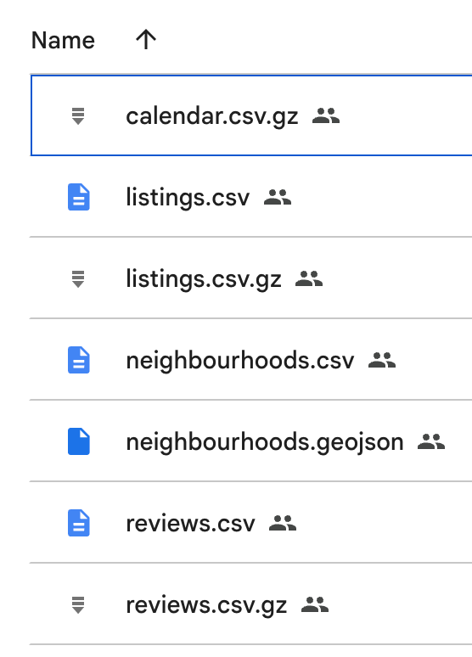
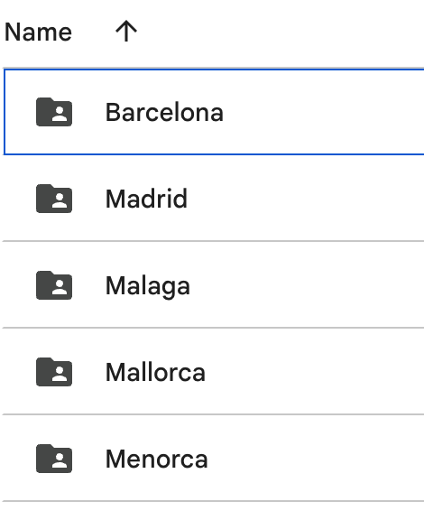
December 12, 2024
Data Loading
Iterated through folders containing city-specific .csv.gz files.
Created a dictionary (dataframes) to store listings, reviews, and calendar data for each city in Spain.
Ensured proper error handling for missing files, parsing issues, and non-.csv.gz files.

Slide 6
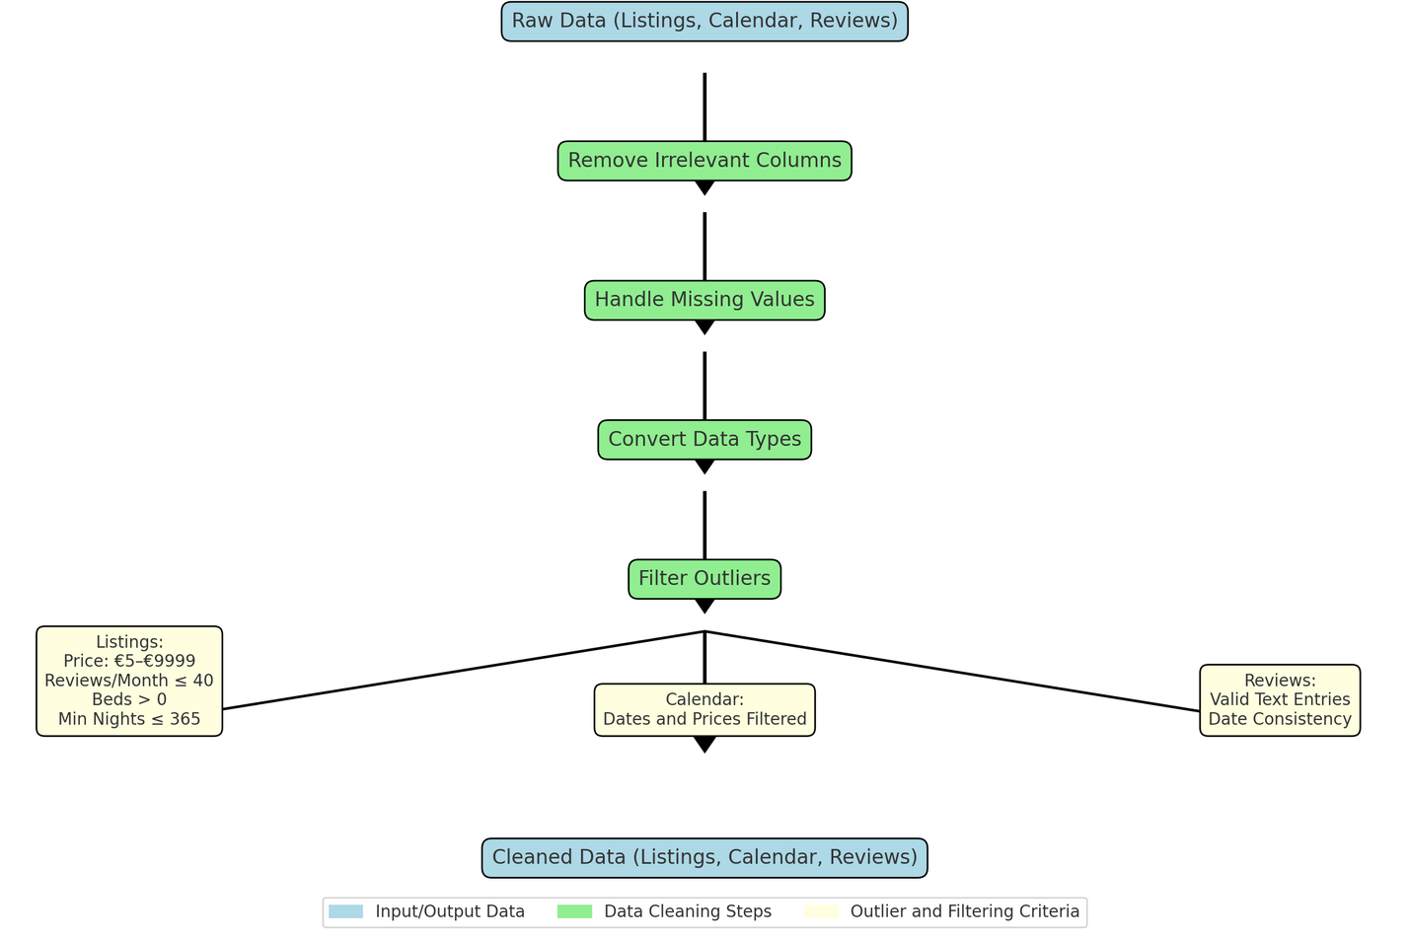
December 12, 2024
Data Cleaning

Slide 7
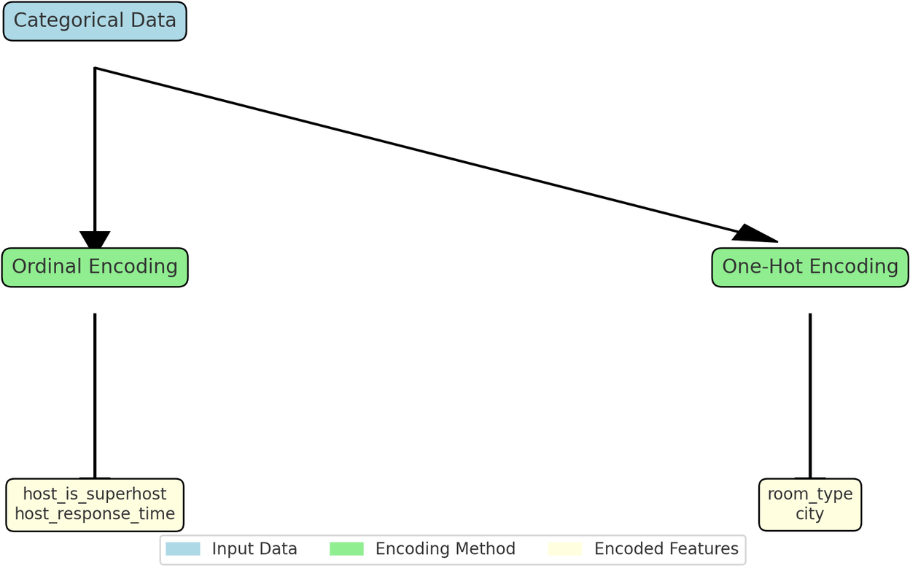
December 12, 2024
Categorical Variable Encoding
listings2: DataFrame of all cleaned listings data

Slide 8
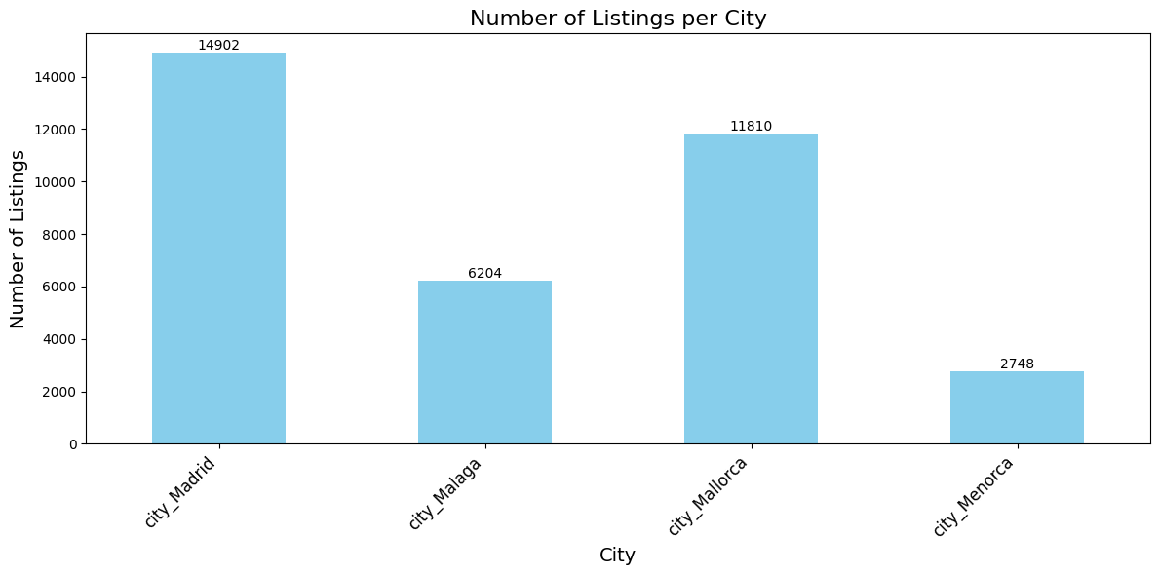
December 12, 2024

Slide 9
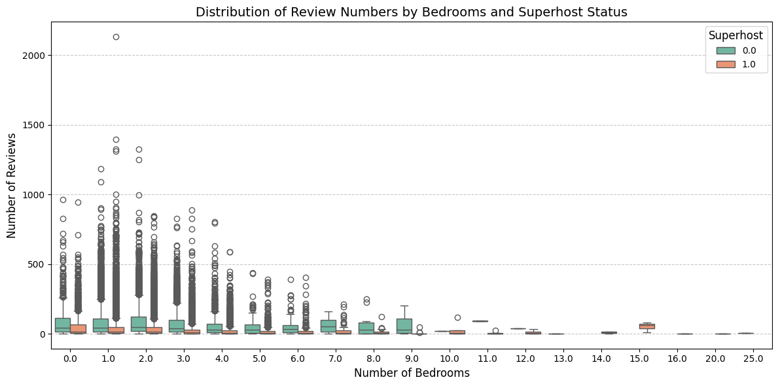
December 12, 2024

Slide 10
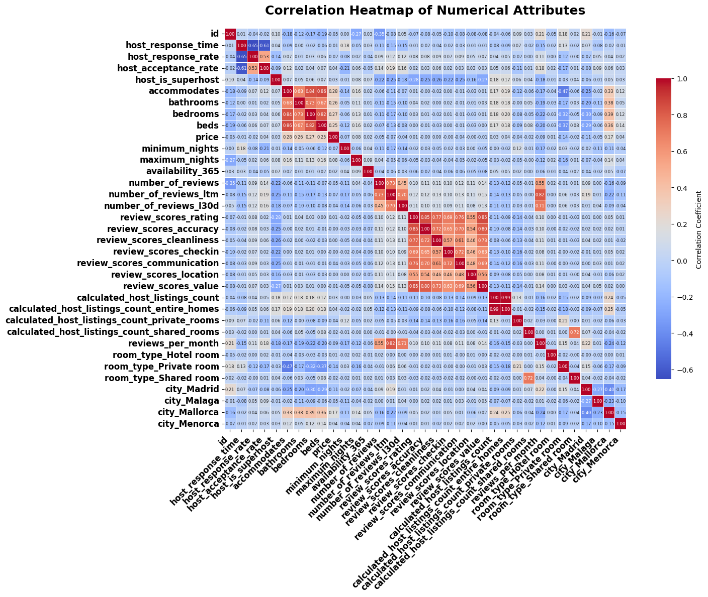
December 12, 2024

Slide 11
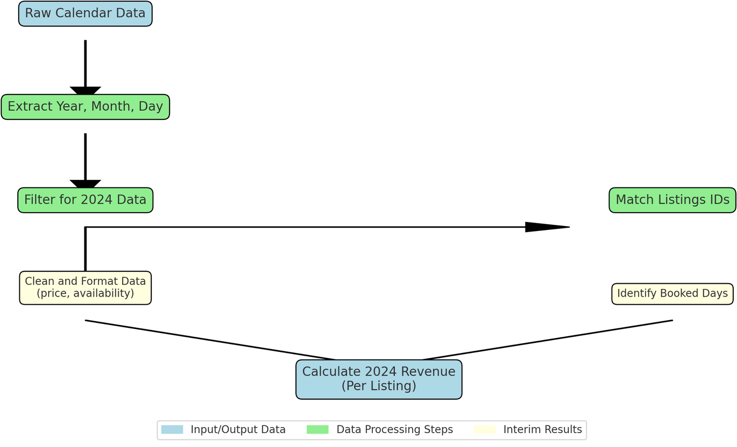
December 12, 2024
Revenue Calculations
calendar2: DataFrame of all cleaned calendar data

Slide 12
Model and Feature Selection

Slide 13
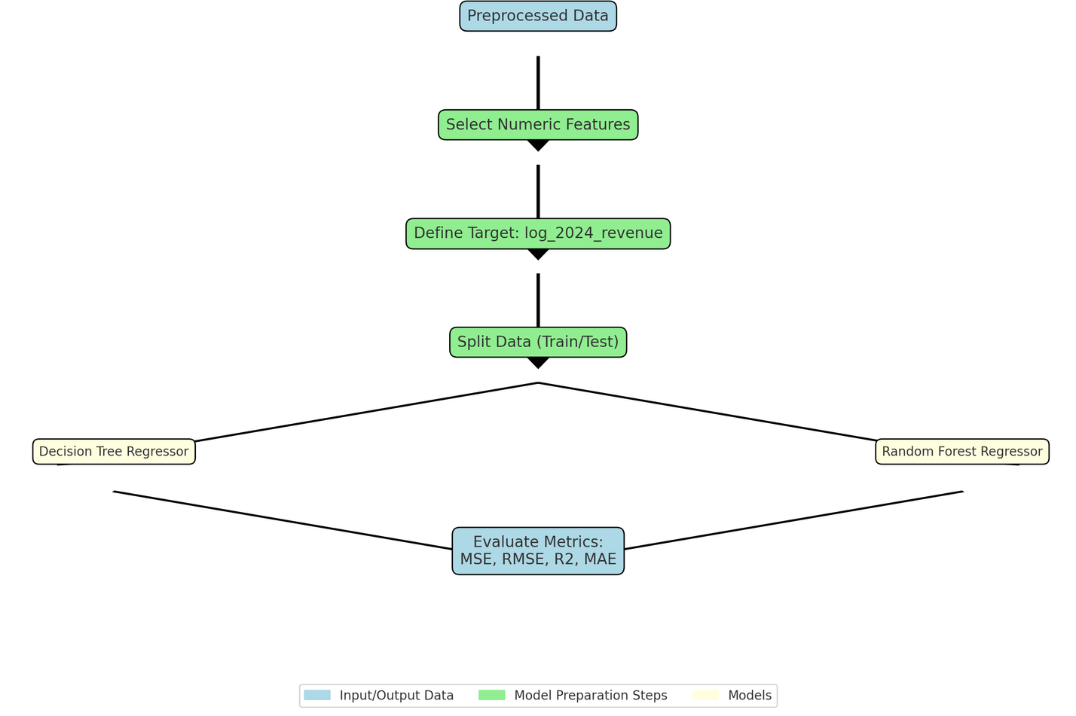
Models
December 12, 2024
Feature Selection:
Selected numeric predictors relevant to the target (log_2024_revenue) while excluding identifiers and highly correlated features like price and availability_365.
Ensured features are scaled appropriately for the model requirements.
Model Selection:
Decision Tree Regressor:
Simplicity in interpreting splits and feature importance.
Risk of overfitting if the tree grows too deep.
Random Forest Regressor:
Aggregates multiple decision trees to reduce overfitting and improve generalization.
Robust against noisy data with better predictive performance.

Slide 14
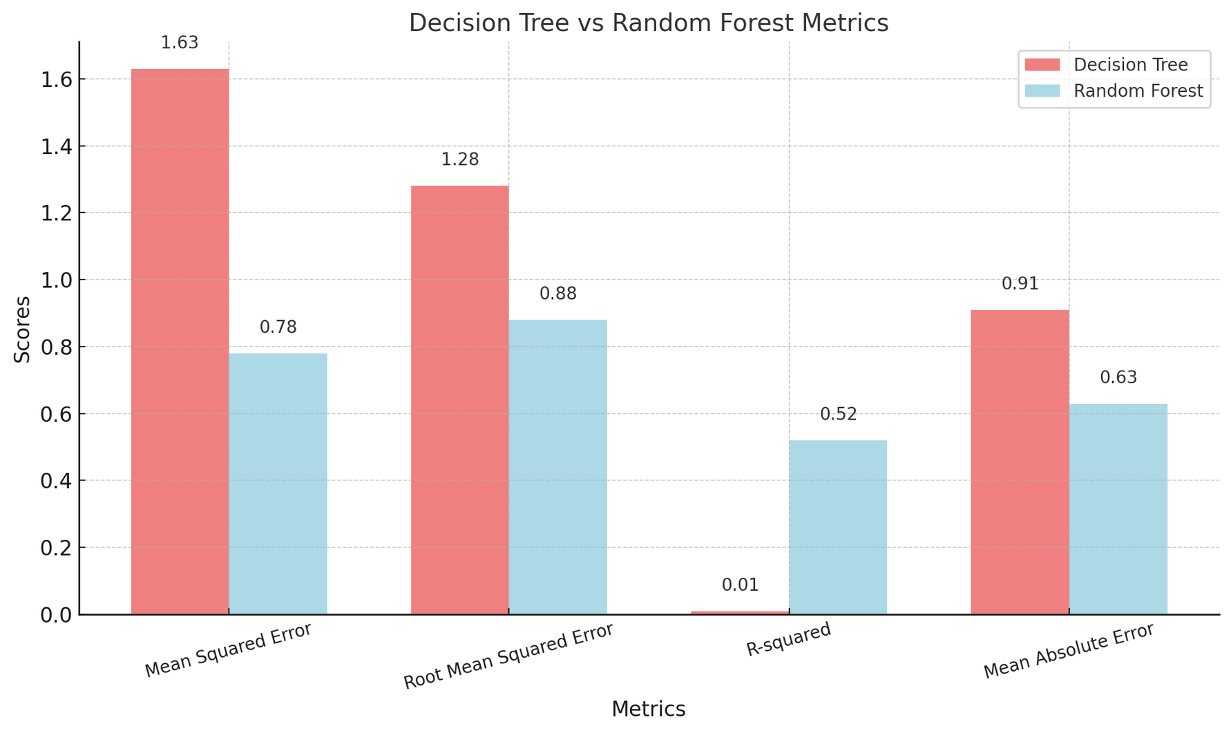
Model Results
December 12, 2024

Slide 15


December 12, 2024
Model Selection for Analysis
Random Forest vs. Decision Tree Performance:
Random Forest significantly outperforms the Decision Tree
Higher R-squared: 0.52 vs. 0.01.
Lower Mean Squared Error (MSE) and Mean Absolute Error (MAE), indicating better predictive accuracy.
Stronger ability to capture underlying patterns in the data.
Interpretability:
Decision Tree offers simplicity and transparency
Useful for analyzing feature importance and identifying key revenue drivers.
Insights into how features influence predictions.
Conclusion:
Random Forest for accuracy.
Decision Tree for interpretability and strategic insights.

Slide 16
Analysis

Slide 17
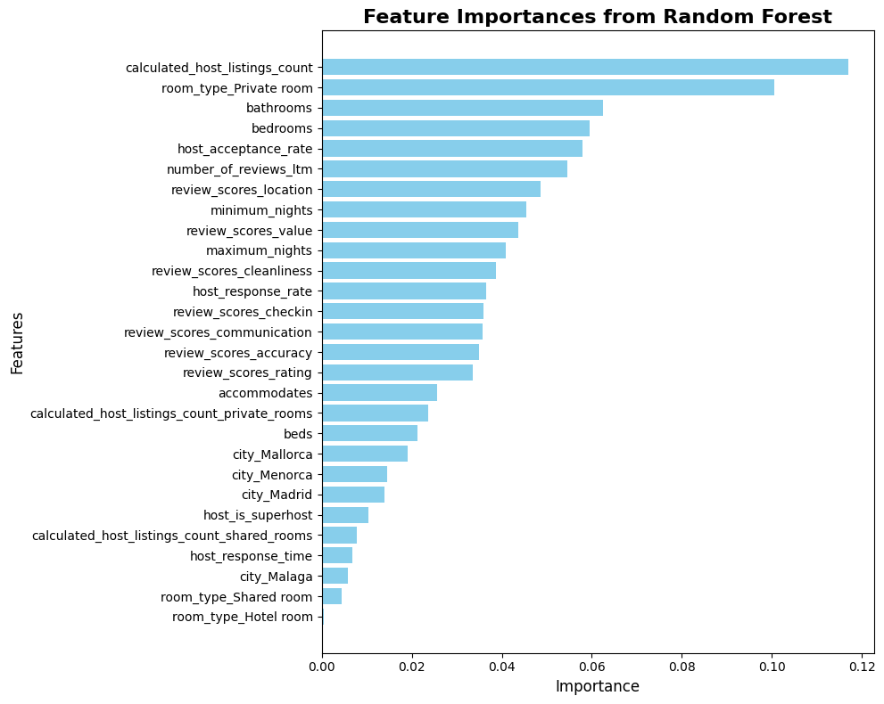
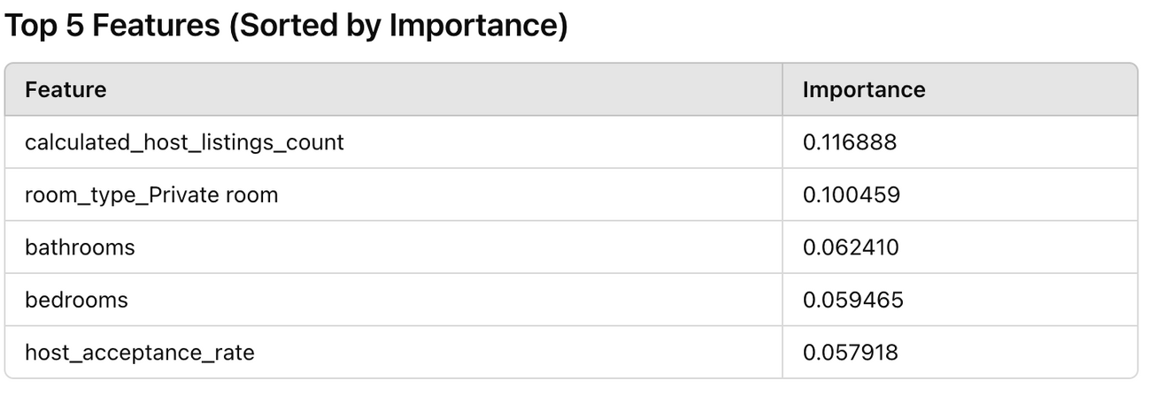
December 12, 2024
Feature Analysis - Random Forest

Slide 18
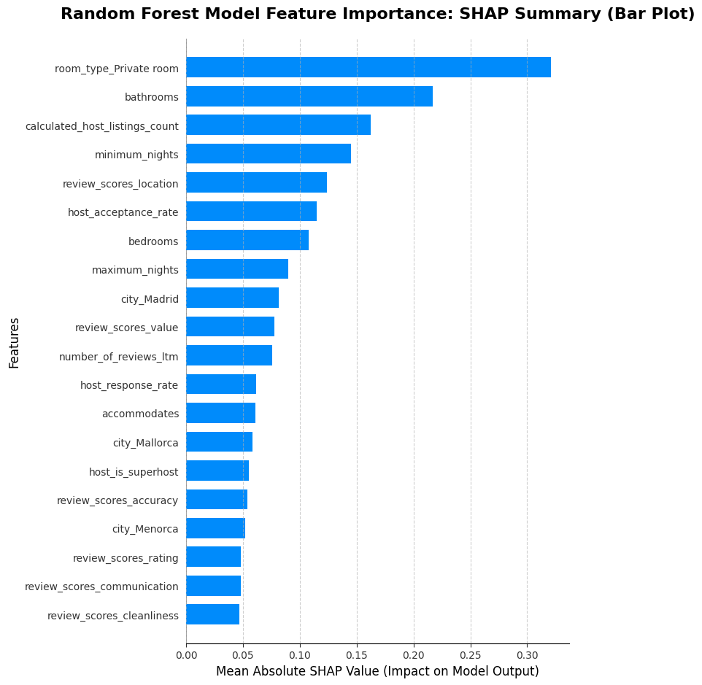
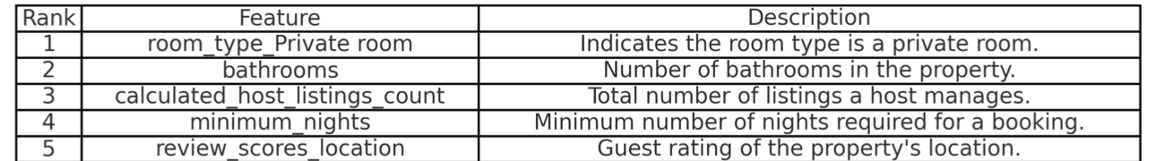
December 12, 2024
Feature Analysis - Decision Tree
Decision Tree Model Feature Importance: SHAP Summary (Bar Plot)

Slide 19
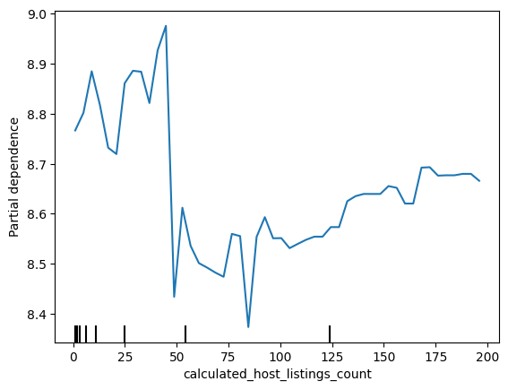
Partial Dependence Plot
calculated_host_listings_count
December 12, 2024
Complex non-linear relationship; confounding factors
Moderate number of listings might be associated with higher revenue
Excessive number of listings can lead to fluctuations and even a decline
Large portfolio requires careful resource allocation and may face challenges related to maintaining high-quality service and managing competition

Slide 20
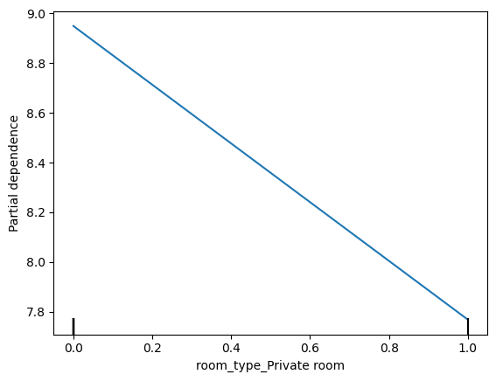
Partial Dependence Plot
room_type_Private room
December 12, 2024
Negative association
Properties listed as "private rooms" might be associated with lower revenue or less favorable outcomes compared to other room types (eg, entire homes)

Slide 21
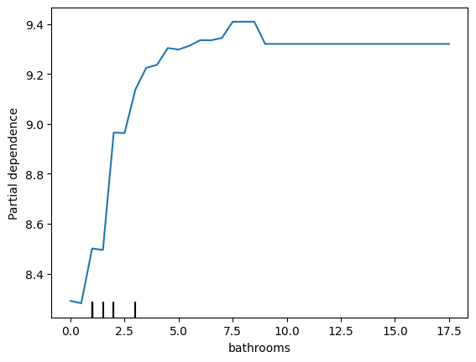
Partial Dependence Plot
bathrooms
December 12, 2024
Positive association
Properties with more bathrooms tend to have higher predicted revenue
Diminishing returns, with the initial increase in revenue being more pronounced for the first few bathrooms

Slide 22
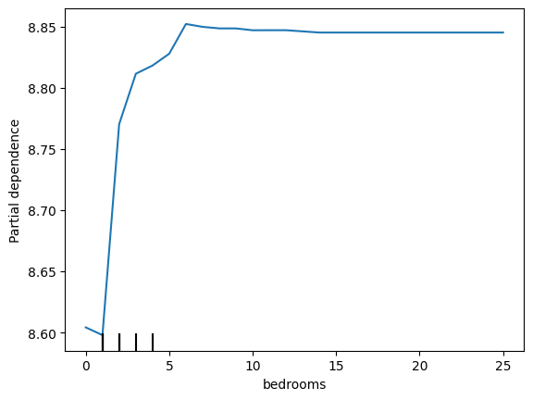
Partial Dependence Plot
bedrooms
December 12, 2024
Positive association
Properties with more bedrooms tend to have higher predicted revenue
Diminishing returns, with the initial increase in revenue being more pronounced for the first few bedrooms

Slide 23
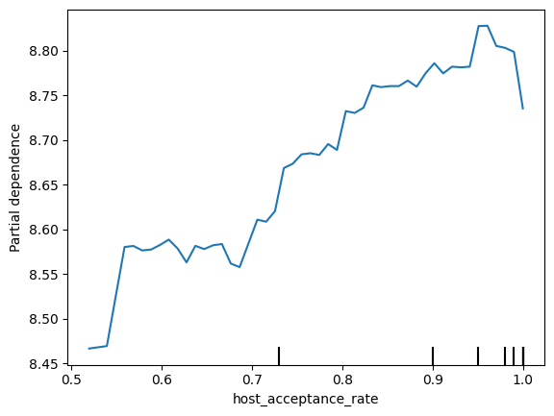
Partial Dependence Plot
host_acceptance_rate
December 12, 2024
Positive association
Properties with higher host_acceptance_rate tend to have higher predicted revenue
Diminishing returns over time, likely due to potential scams by hosts or other confounding factors

Slide 24
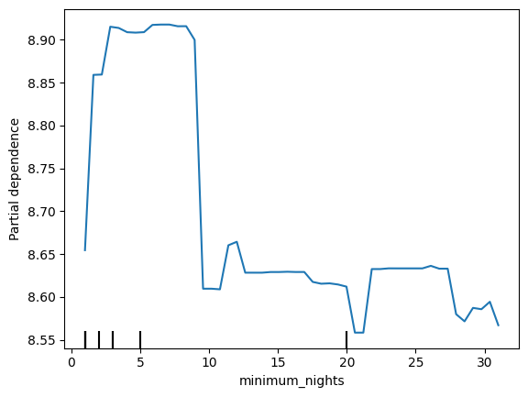
Partial Dependence Plot
EXTRA: minimum_nights
December 12, 2024
Complex non-linear relationship
Moderate minimum stay might be associated with higher revenue
Excessive minimum stay can lead to fluctuations and even a decline

Slide 25
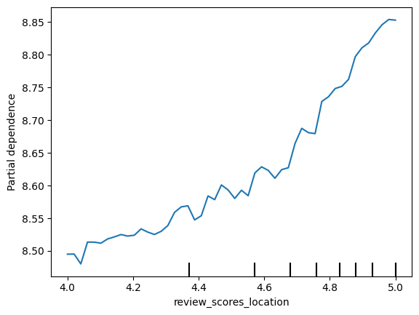
Partial Dependence Plot
EXTRA: review_scores_location
December 12, 2024
Strong, positive relationship
Higher location scores tend to have higher predicted revenue
Guests value well-located properties

Slide 26
Conclusion

Slide 27


Conclusion
For investors to maximize Airbnb revenue, these findings should be used to refine property features, pricing strategies, and listing descriptions to maximize revenue.
# Properties, Regulations
Best # Bedrooms
Attract More Bookings
Mallorca
3-5 Bedrooms
Moderate
Ideal City
House or Large Apt.
Minimum Stay Policy & Portfolio Size
Entire house or apartment is best
The more, the better
Private Room
↑Bathrooms
Worst Room Type
Compensate for Room Type

Slide 28

Next Steps
Cost Analysis
Review Analysis
Integrate property price data from Zillow to understand net profit from purchase costs and rental revenue potential.
Analyze the trend of review volumes (rising or falling) over the past 12-24 months. Identify property types with consistently improving or declining reviews.
Sentiment Analysis
Geospatial Analysis
Extract customer sentiment from reviews to identify high-impact amenities. Highlight amenities most frequently associated with positive reviews (cleanliness, Wi-Fi quality, etc.)
Map Airbnb properties along major tourist attractions, transportation hubs, and nightlife spots to identify zones with high-performing properties (based on reviews, occupancy rates, and/or revenue).

Slide 29

Thank You!
Any Questions?

